Slide 1

Amazon Review Analysis John he
“Ten gods cannot change the opinion of one fool, especially if another fool agrees with him.”(ABRAHAM MILLER)

Slide 2




EDA
Summary
Average length of Non Verified Purchaser
Average length of Verified Purchaser
Average Review Length
177
170
245
5,906,333 Rows
Columns: 'star_rating','helpful_votes','total_votes','vine','verified_purchase','review_headline','review_body','review_date'
Missing Data
Verified Purchased
5 Star Rating
89%
👍
56%
2
Missing data: helpful votes
Unbalanced Labels
90% Y vs 10% N
Most people gave 5 star ratings

Slide 3
Why do businesses care about reviews?
Improve Sales
Improve products/ Experiences
Reduce fake reviews

Slide 4
Re-Sample
5,000;10,000;50,000
Under sample
1,186,926
Cross-validation
Test size: 10%

Slide 5
Models
Simple RNN
Baseline model
LSTM
Best Results
GRU
Efficient Model

Slide 6
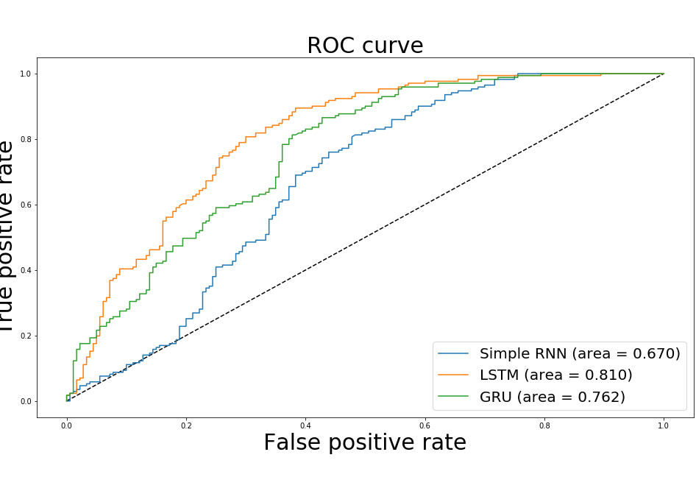
AUC ROC

Slide 7
Conclusions
Best Model: LSTM
Future Research
Build more complex model with star rating
Generate display strategies for reviews
Suggest product improvements for businesses

